Slide 1



Next.js and Next-Auth
Ref: https://nextjs.org/
www.arkilos.com | enquiries@arkilos.com
Arkilos Inc. 2022 © All Rights Reserved

Slide 2
What is Next.js?
Next.js is an open-source web development framework created by the private company Vercel providing React-based web applications with server-side rendering and static website generation.
www.arkilos.com | enquiries@arkilos.com
Arkilos Inc. 2022 © All Rights Reserved

Slide 3

Features of Next.js
www.arkilos.com | enquiries@arkilos.com
Arkilos Inc. 2022 © All Rights Reserved

Slide 4
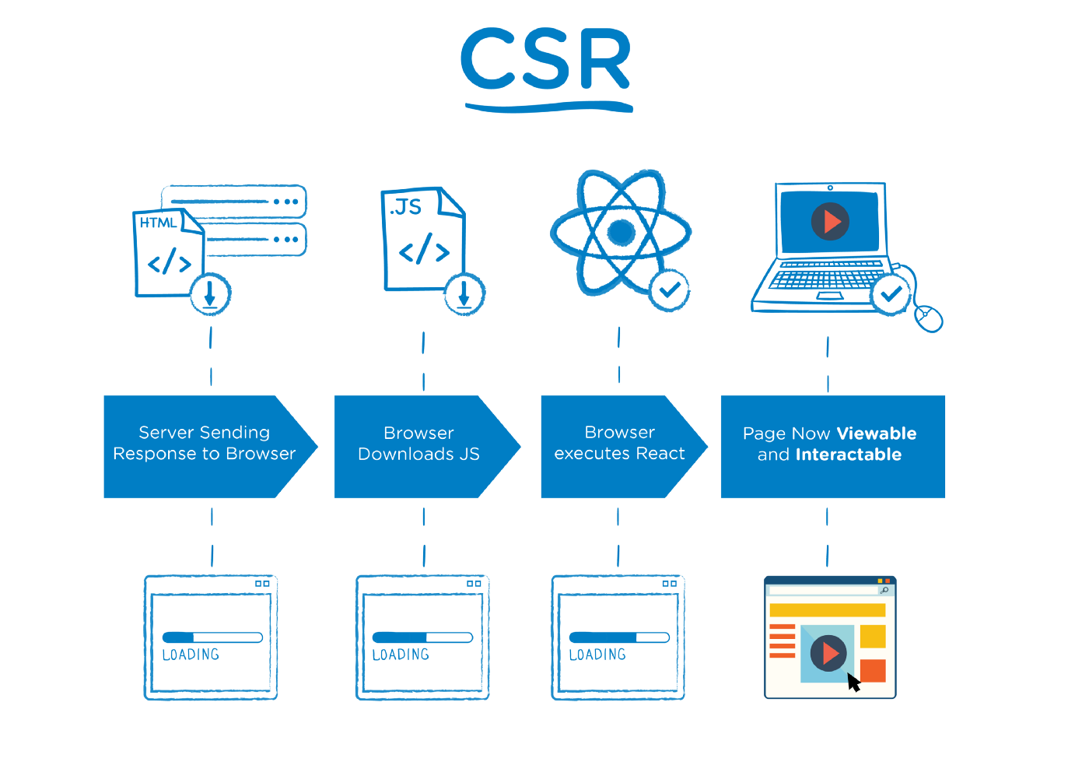
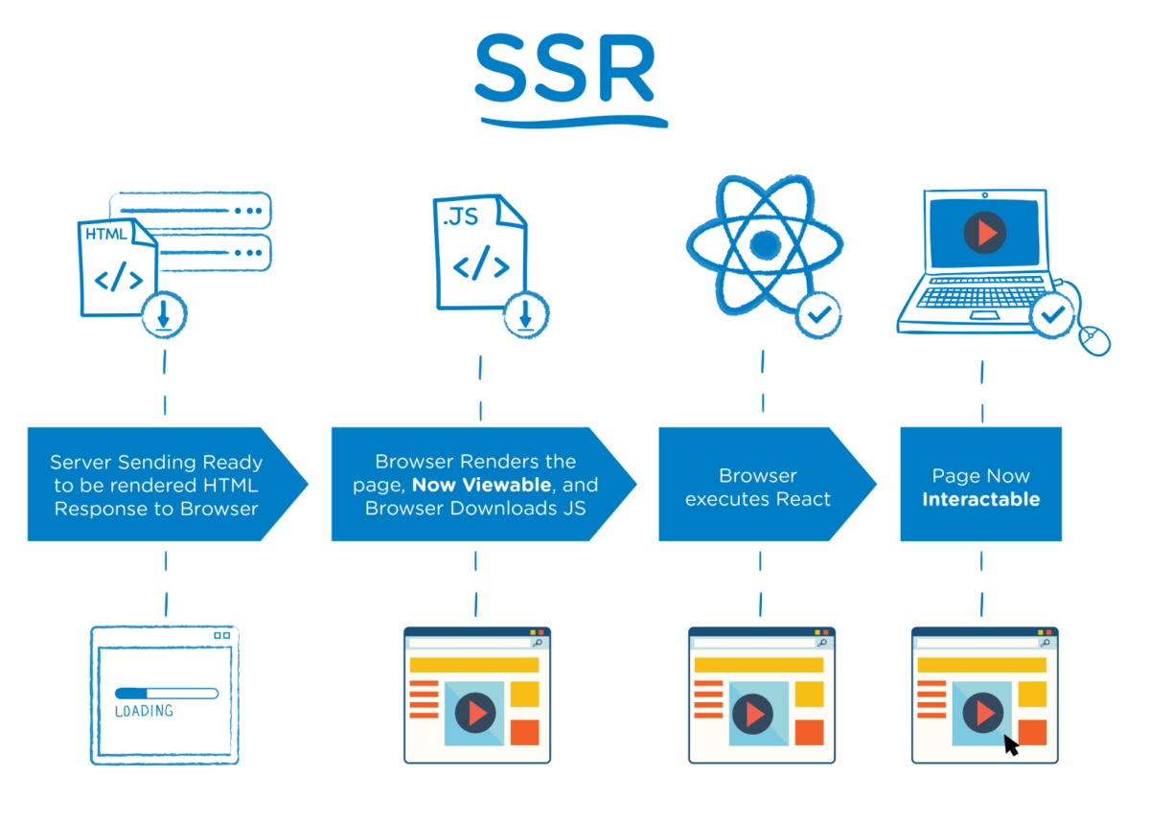
CSR vs SSR
www.arkilos.com | enquiries@arkilos.com
Arkilos Inc. 2022 © All Rights Reserved

Slide 5
Next Auth
NextAuth.js is a complete open-source authentication solution for Next.js applications. It is designed from the ground up to support Next.js and Serverless. NextAuth. js is designed to avoid the need to store passwords for user accounts. If you have an existing database of usernames and passwords, you can use a custom credentials provider to allow signing in with a username and password stored in an existing database.
www.arkilos.com | enquiries@arkilos.com
Arkilos Inc. 2022 © All Rights Reserved

Slide 6
Providers of Next Auth
42 School, Amazon Cognito,Apple,Atlassian,Auth0,Authentik,Azure Active Directory , Azure Active Directory B2C,Battle.net,Box,BoxyHQ SAML,Bungie,Coinbase,Discord,Dropbox,DuendeIdentityServer6,EVE Online,Facebook,FACEIT,Foursquare,Freshbooks,FusionAuth,GitHub,GitLab,Google,HubSpot,IdentityServer4,Instagram,Kakao,Keycloak,LINE,LinkedIn,Mail.ru,Mailchimp,Medium,Naver,Netlify,Okta,OneLogin,Osso,Osu!,Patreon,Pinterest,Pipedrive,Reddit,Salesforce,Slack,Spotify,Strava,Todoist,Trakt,Twitch,Twitter,UnitedEffects,VK,Wikimedia,WordPress.com,WorkOS,Yandex,Zitadel,Zoho,Zoom,
www.arkilos.com | enquiries@arkilos.com
Arkilos Inc. 2022 © All Rights Reserved

Slide 7
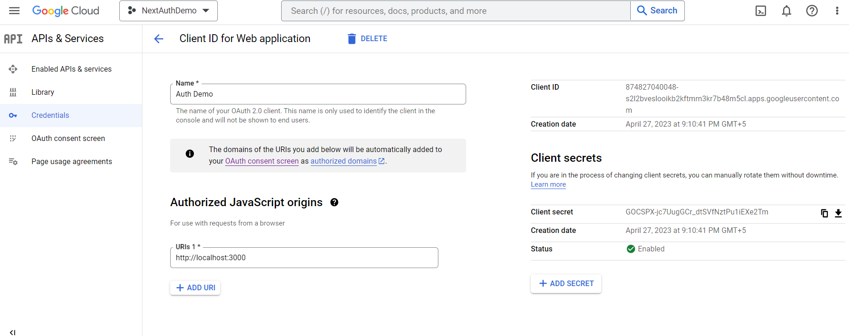
www.arkilos.com | enquiries@arkilos.com
Arkilos Inc. 2022 © All Rights Reserved

Slide 8
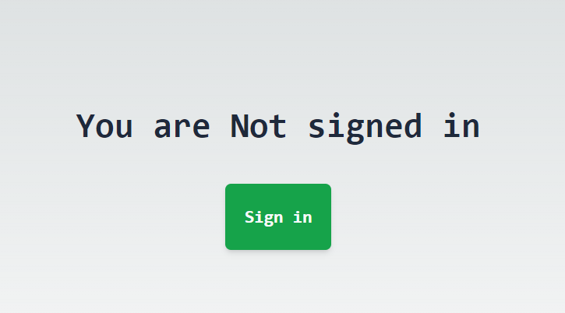
Client Side
www.arkilos.com | enquiries@arkilos.com
Arkilos Inc. 2022 © All Rights Reserved

Slide 9
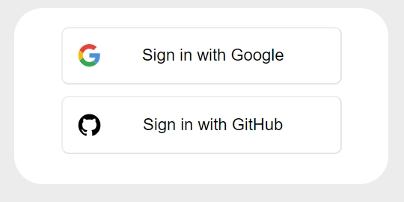
www.arkilos.com | enquiries@arkilos.com
Arkilos Inc. 2022 © All Rights Reserved

Slide 10
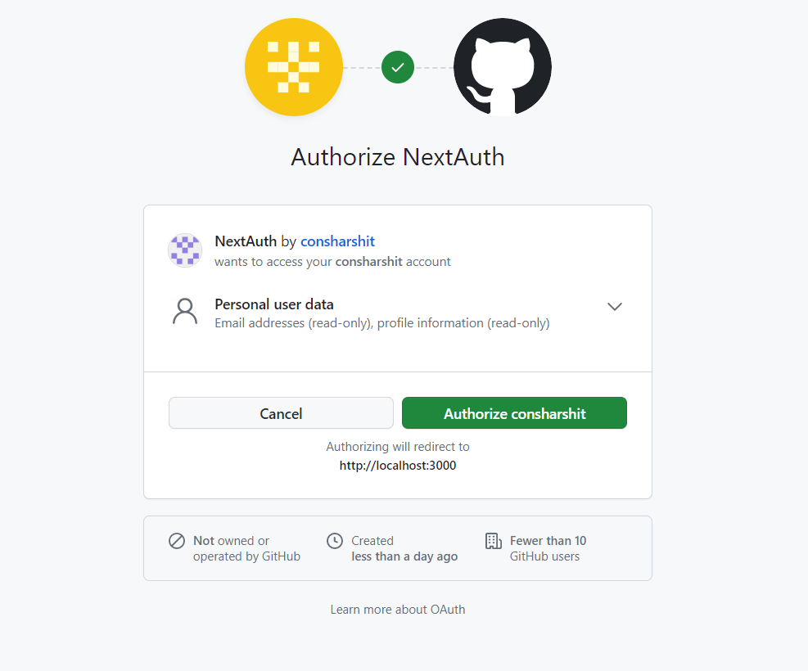
www.arkilos.com | enquiries@arkilos.com
Arkilos Inc. 2022 © All Rights Reserved

Slide 11
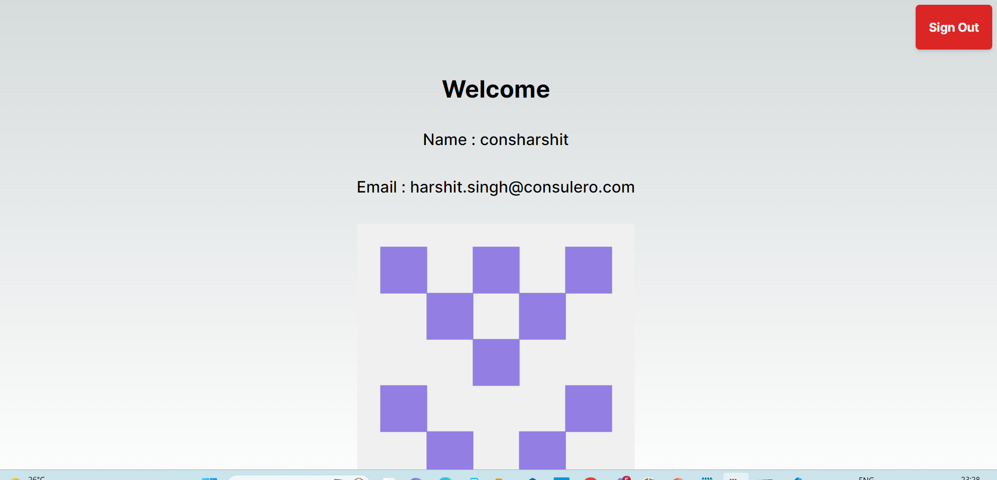
www.arkilos.com | enquiries@arkilos.com
Arkilos Inc. 2022 © All Rights Reserved

Slide 12
Thank You!!
www.arkilos.com | enquiries@arkilos.com
Arkilos Inc. 2022 © All Rights Reserved

